Slide 1

Arduino Programming

Slide 2
Who are we?
Lucian Silcox
Instructor, Dept of Computer Science, STC
Estevan Cedillo
Lab Assistant III, Dept of Computer Science, STC
Mario Ramirez
Lab Assistance, Dept of Computer Science, STC

Slide 3
What is Arduino?
Arduino is an open-source hardware and software company.
They produce single-board microcontrollers for use in building digital devices.
Arduino was founded to provide a low-cost and easy-to-use introduction to creating devices that interact with the real world through a variety of sensors and actuators.
They are excellent for both novices and professionals.
They work on a variety of platforms, including Windows, Mac, and Linux.

Slide 4
What is Tinkercad?
Tinkercad is a free, browser-based 3D modeling program by Autodesk.
Among other things, Tinkercad can simulate the design of Arduino circuits.
We’ll use it in place of physical Arduino devices to build our projects today.

Slide 5
Getting Started

Slide 6

Step 1: visit tinkercad.com

Slide 7
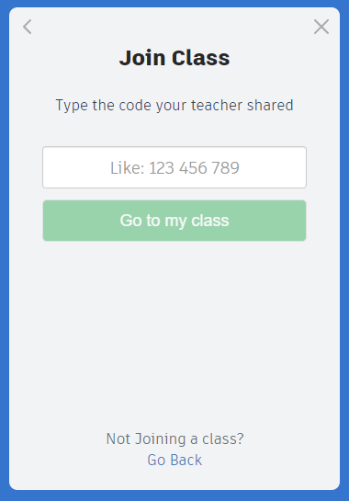
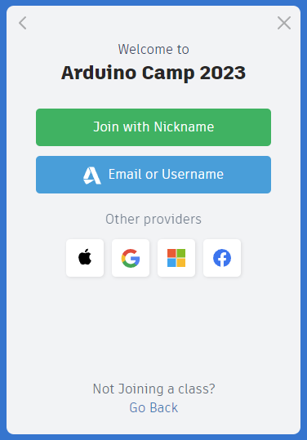
Step 2: JoiN the class
Enter Code:
A19 KWR JDA
Click on
“Join with Nickname”
Enter the nickname provided to you.

Slide 8
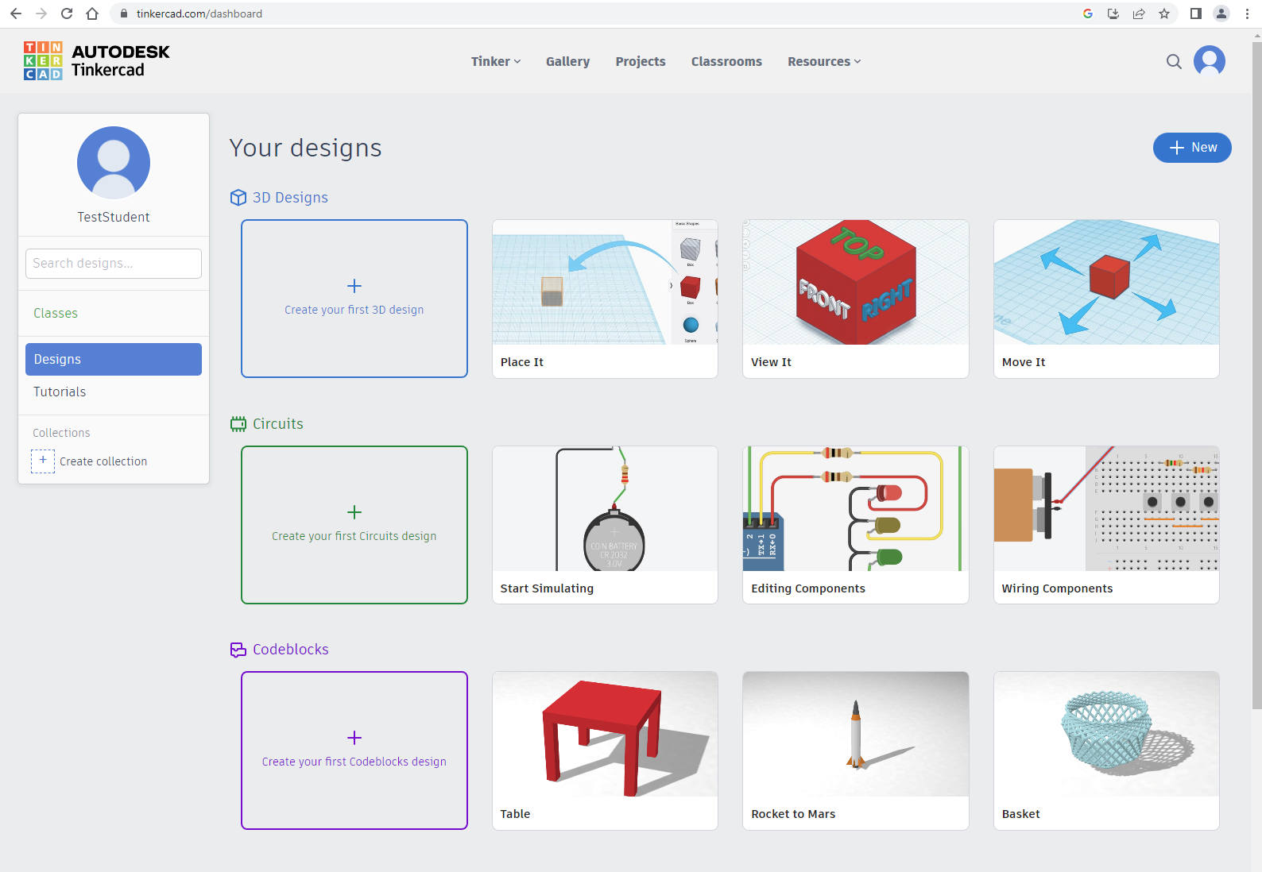
Step 3: Create a new Circuit
You can also create a new Circuit through the “+ New” option.

Slide 9
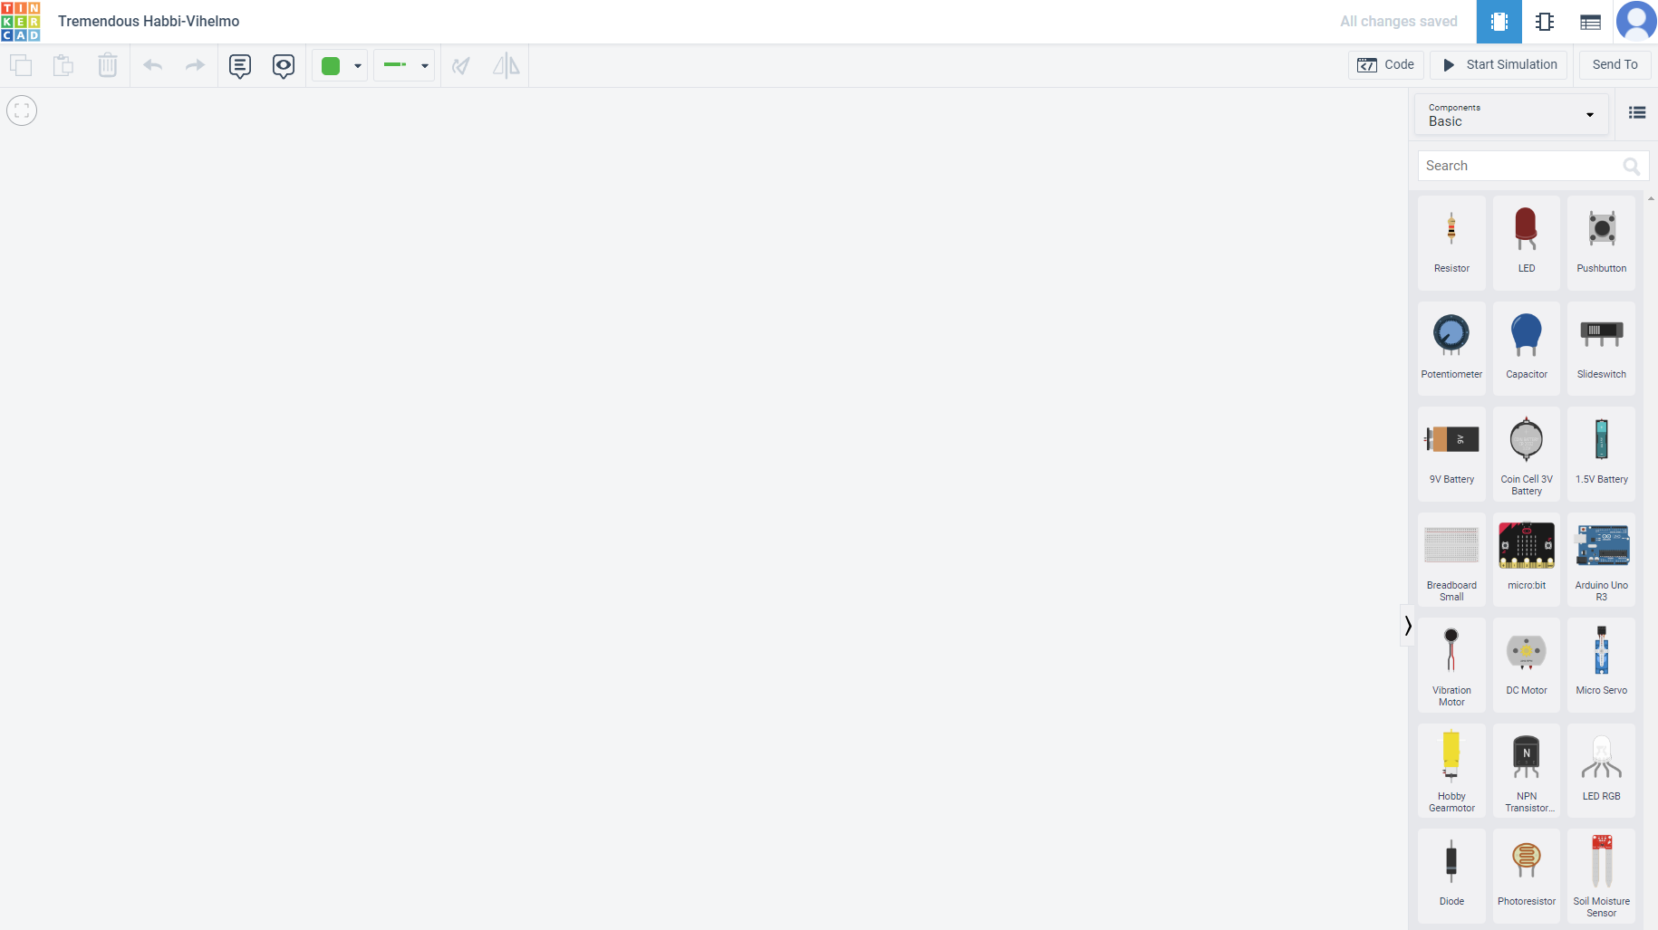
Step 4: Touring Tinkercad
Project Name
Open Code Dialog
Test Your Circuit
Wire Options
Component Part Picker
Circuit Design Area

Slide 10
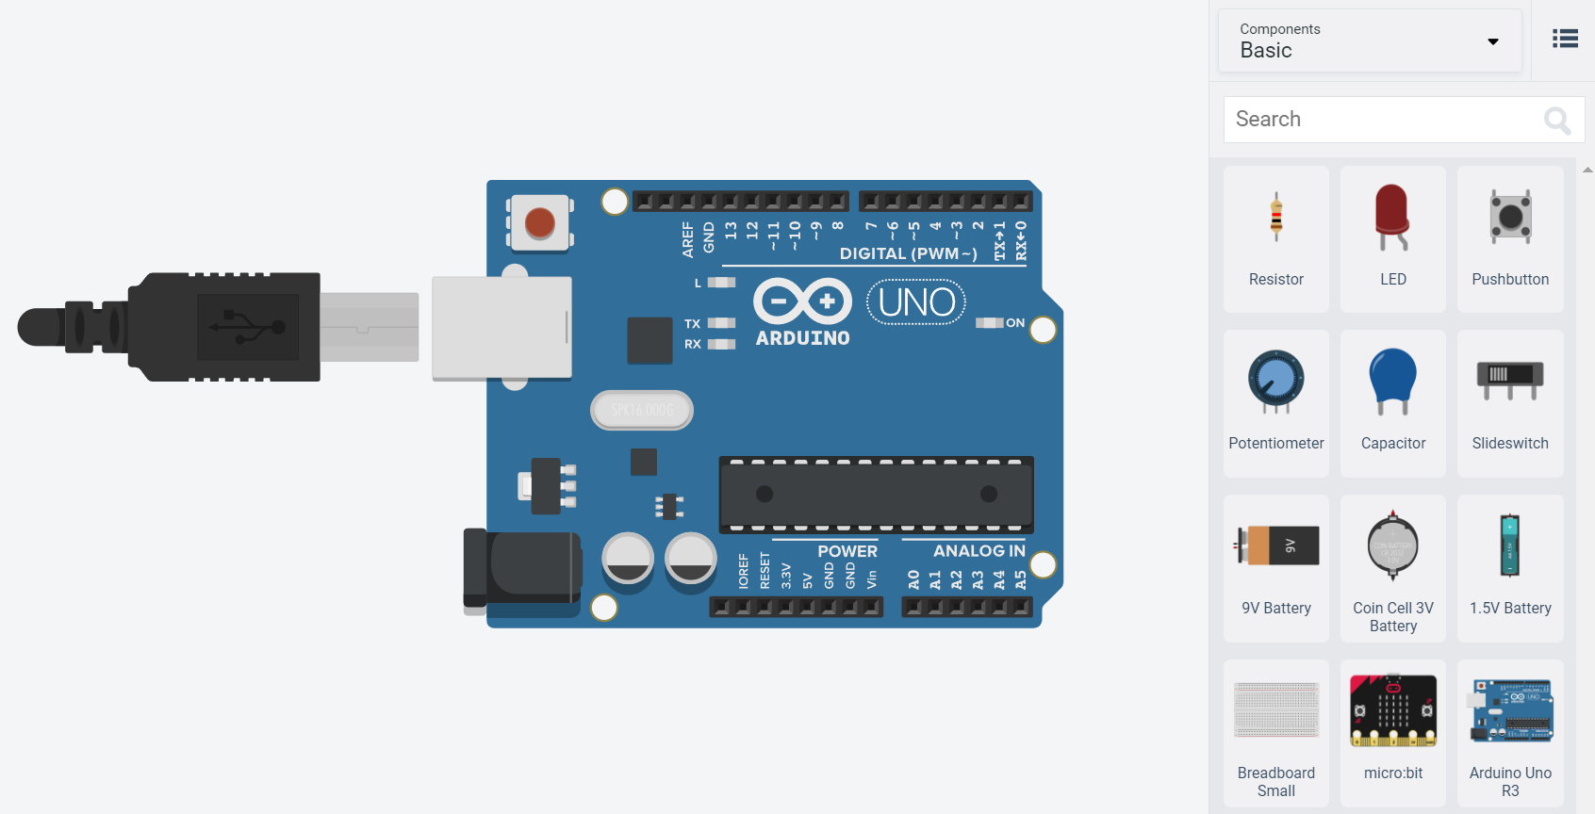
Step 5: Adding an Arduino
Drag an “Arduino Uno R3” into the working area.

Slide 11
Project 1: Blinking Lights

Slide 12
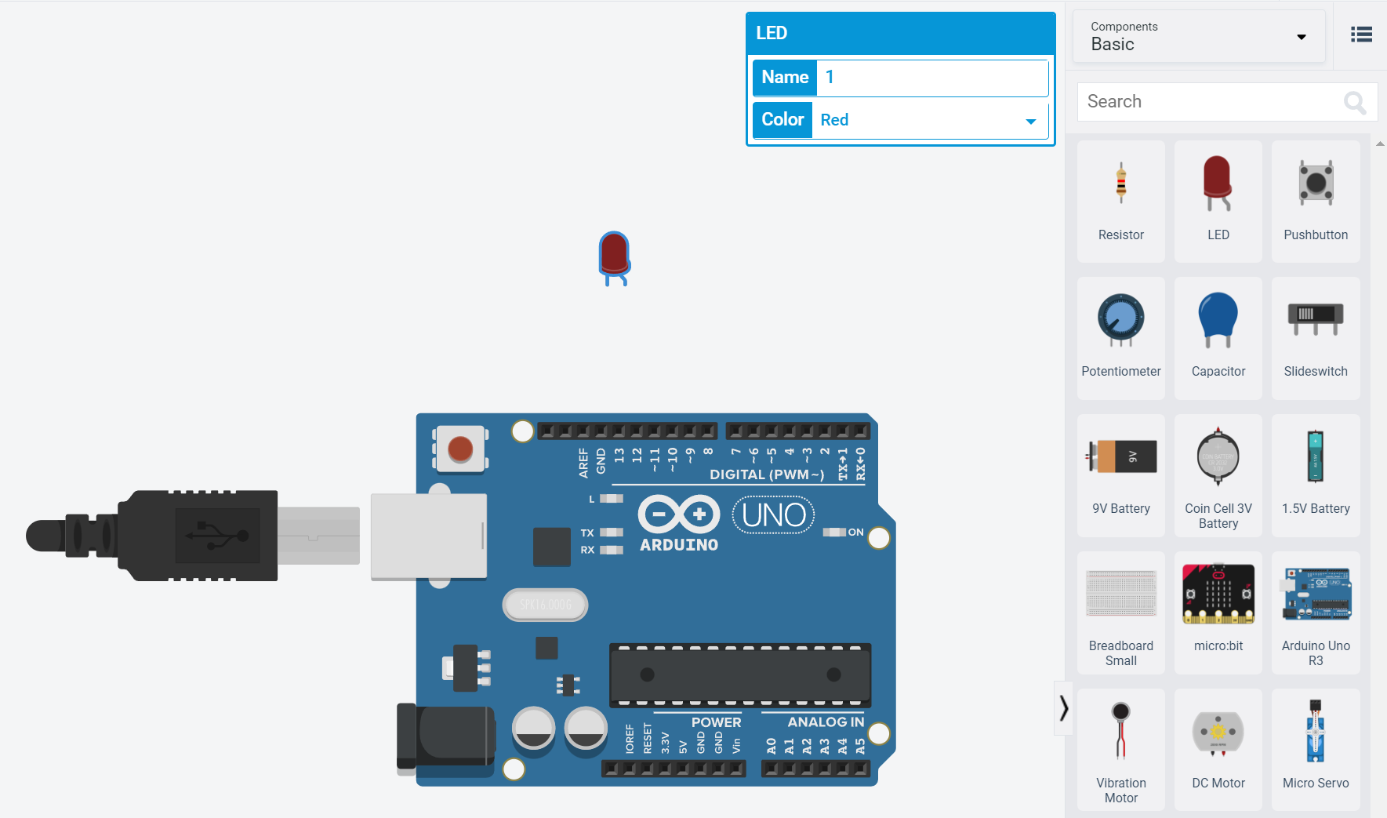
Step 1: Adding an LED Light
LED stands for Light-Emitting Diode. With our new LED selected, we can change the color of the light here.
Drag an “LED” into the working area, placing it somewhere above our Arduino (being above will make the wiring easier).

Slide 13
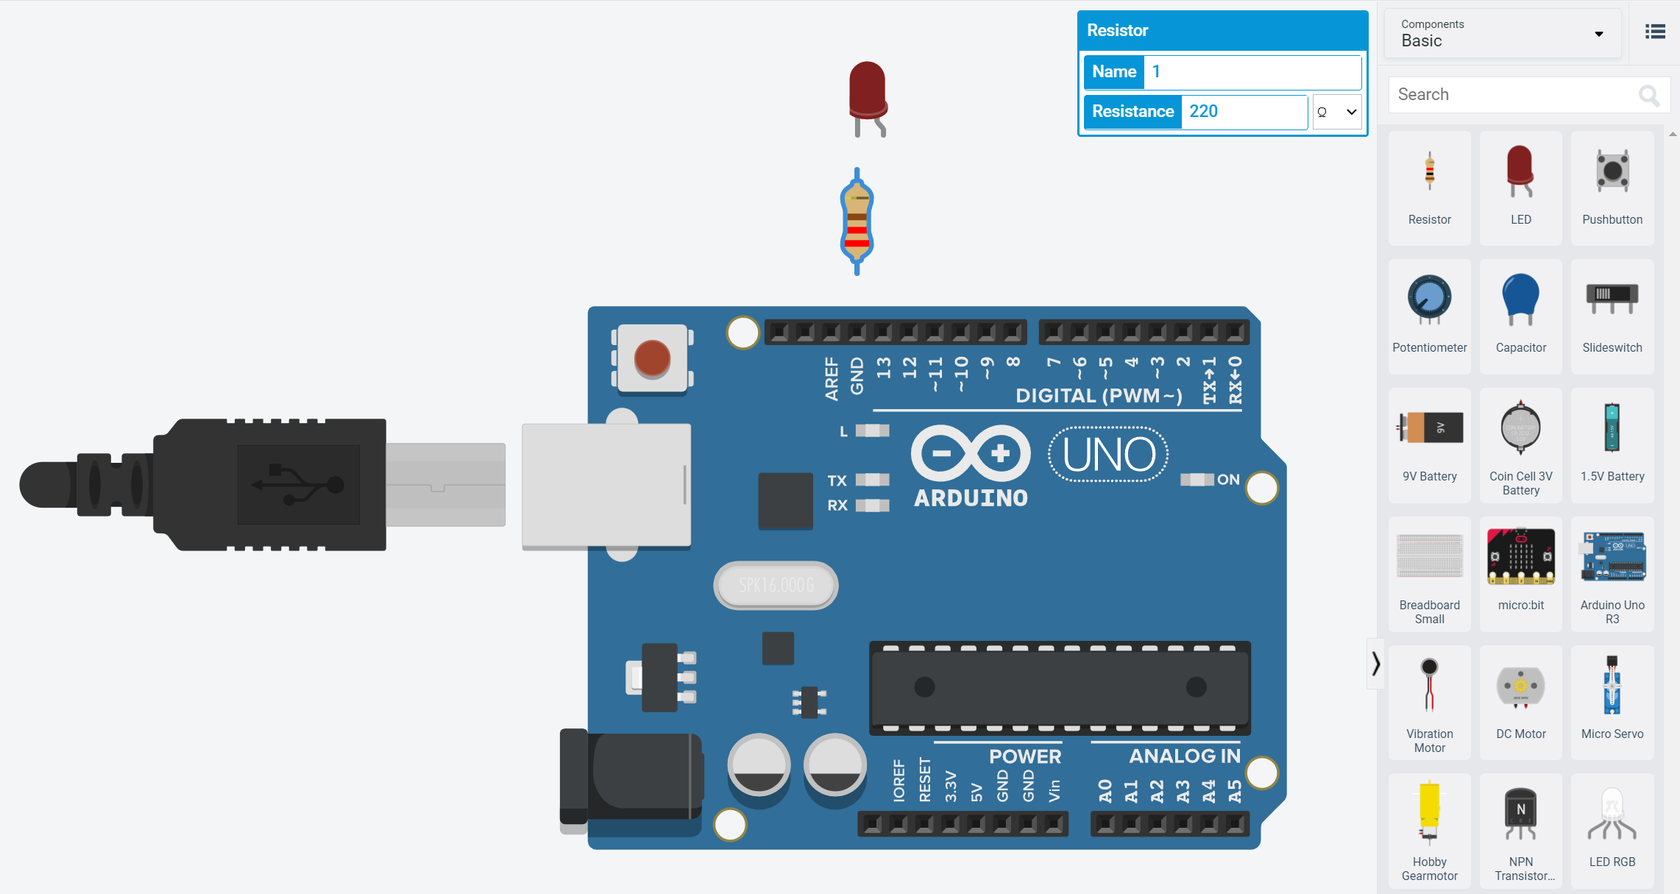
Step 2: Adding A Resistor
A resistor limits the voltage flowing through our wires and will protect our LED from burning out.
The amount of resistance is measured in Ohms (Ω). With our new resistor selected, we can set this one to 220 Ω.
Drag a “Resistor” into the working area. Placing it between the LED and the Arduino will simplify wiring.

Slide 14
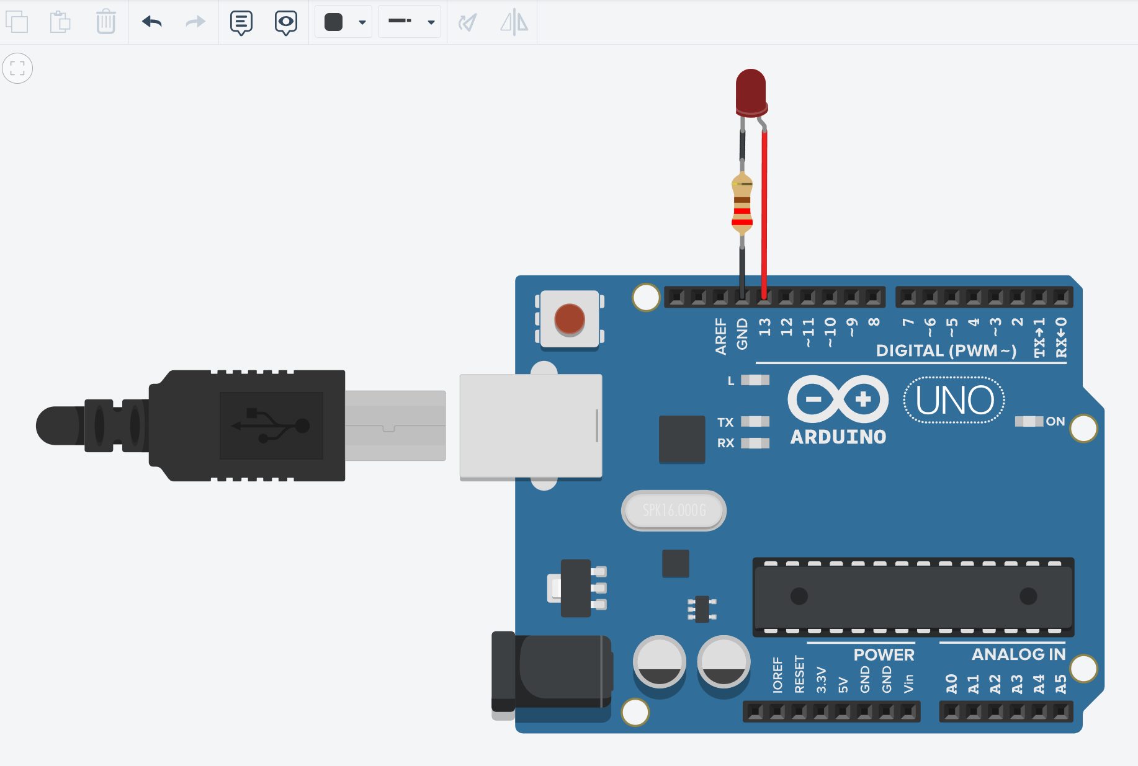
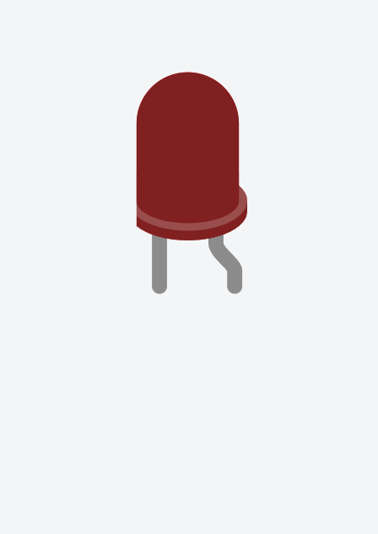
Step 3: Wiring it up
Use this option to change the color of the wires. It’s common to use red for power, and black for ground.
Diodes require current to move in one direction, from a positive Anode to a negative Cathode.
A wire connects the Anode to a digital pin on our Arduino. I’ve used pin 13.
One wire connects the Cathode to the top of the resistor. Another wire connects the bottom of the resistor to ground (GND) on the Arduino.
Cathode
(GND)
Anode
(VCC)

Slide 15
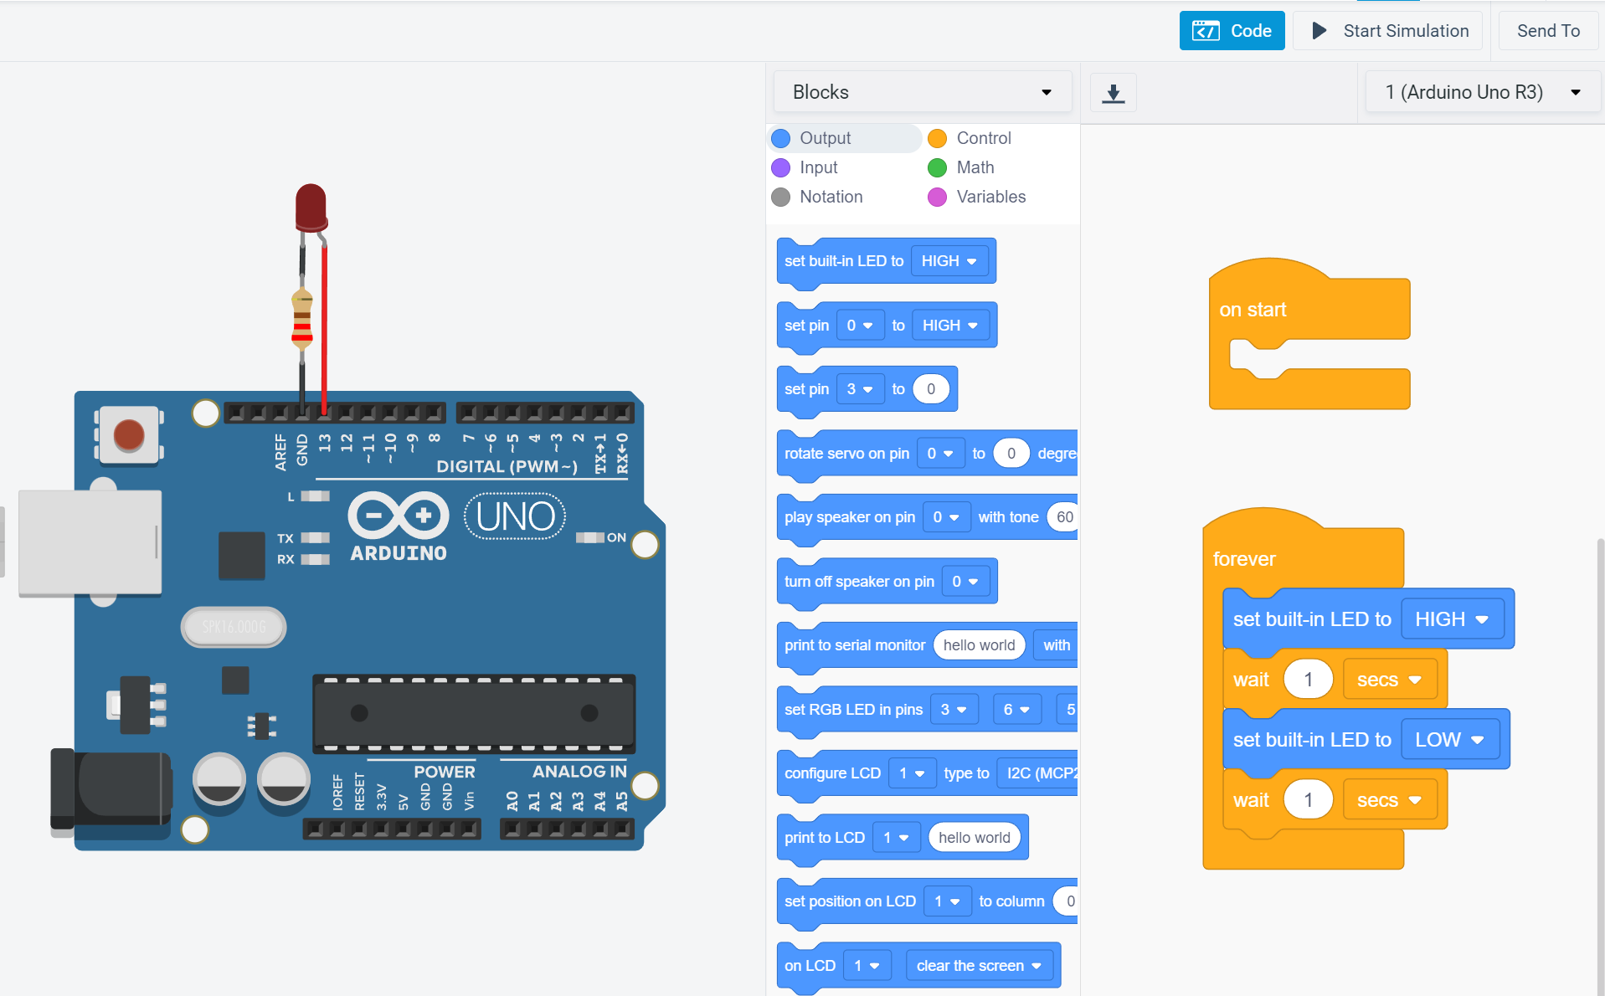
Step 4: Coding the logic
Select “Code” here and you should see something like this.
The built-in LED corresponds to Pin 13, so we can already test this!
Click “Start Simulation” and our light should start blinking on and off.
Try changing the wait time to make it blink faster (or slower).

Slide 16
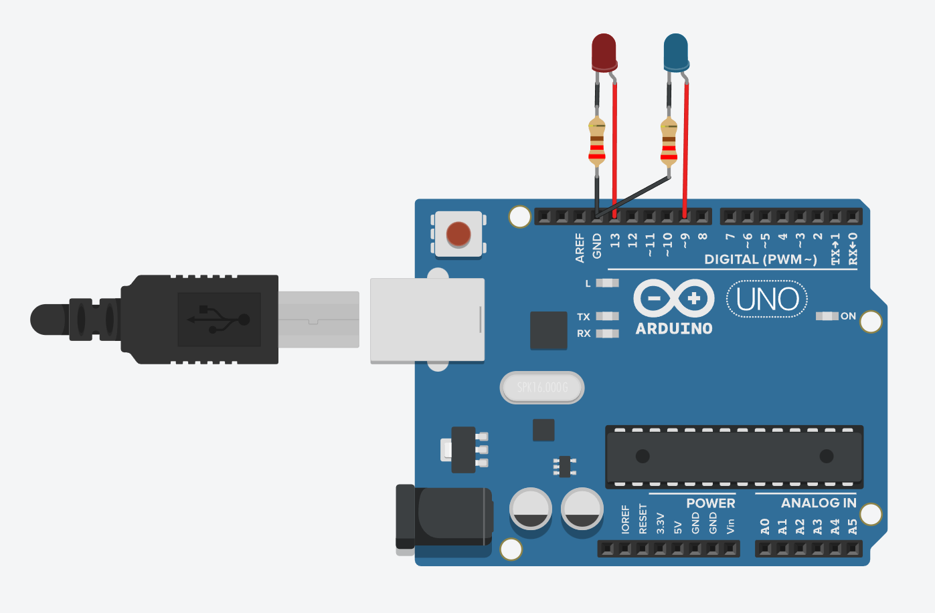
Step 5: Adding A second LED
Let’s add a second LED.
The cathode is connected through the 220 Ω resistor to GND, and the anode connects to a digital pin (I’ve used pin 9).

Slide 17
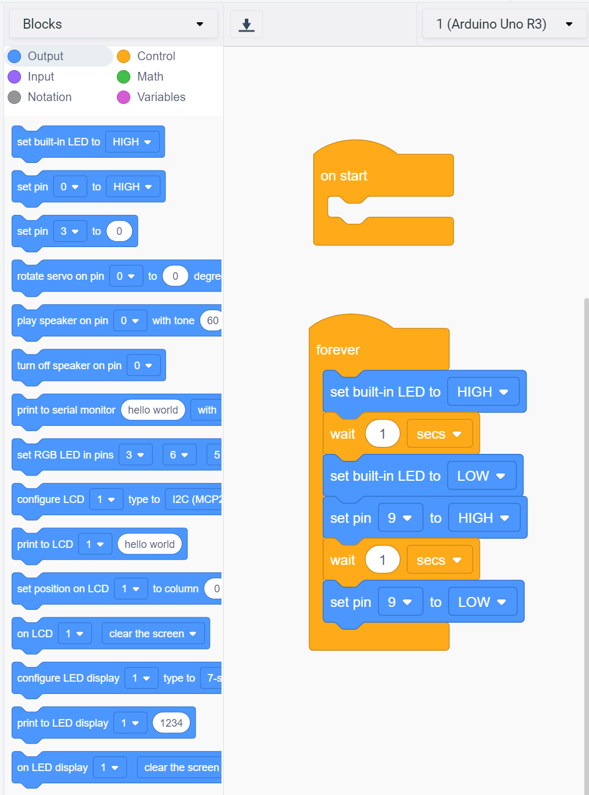
Step 6: Modify the Code
Drag a “Set pin X to HIGH” block (circled) into the code area and drop it into place below “set built-in LED to LOW.”
Change the number of the pin to match your new LED (mine is 9). This will turn on pin 9 immediately after pin 13 turns off.
Drag another one and snap it into place below the second wait. Change this one to set the same pin to LOW, turning the new light off.

Slide 18
Project 2: PushButton Lights

Slide 19
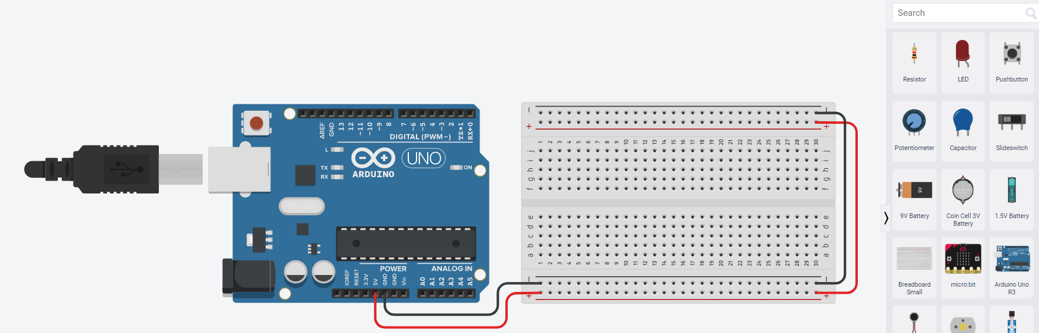
Step 1: Adding a BreadBoard
Each row is connected internally, but not across the center channel.
Drag a “Breadboard Small” into the work area.
Attach wires as seen here to connect the breadboard to both power (5V) and ground (GND).

Slide 20
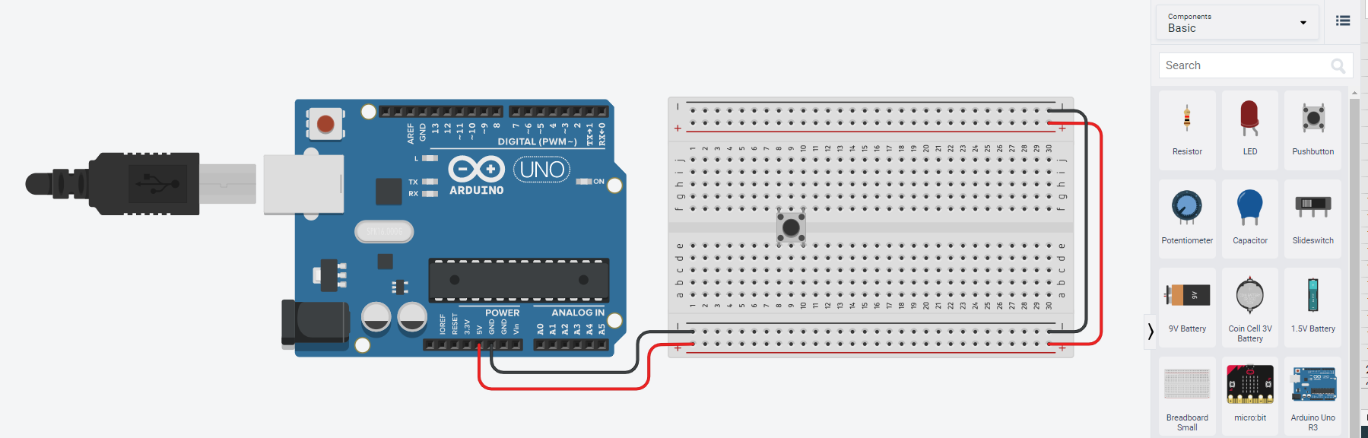
Step 2: Adding A pushbutton
Drag a “Pushbutton” into the work area, placing it on the breadboard over the center channel.
I’ve placed it on rows 8 and 10, but it doesn’t have to be.

Slide 21
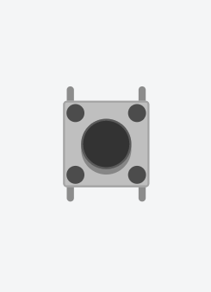
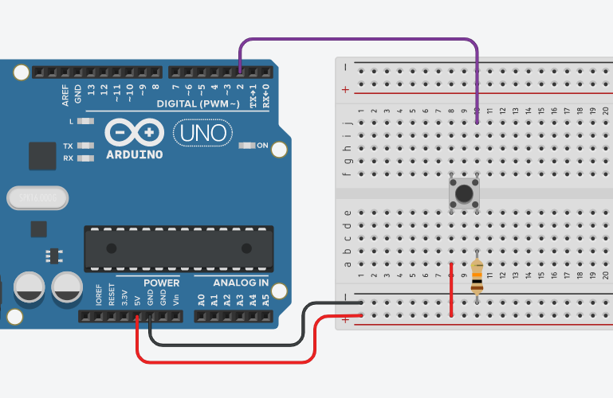
Step 3: Wiring the Pushbutton
Internally, the pins opposite each other are connected.
When the button is pushed, the two sides are connected.
A wire connects the output pin to a digital pin on the Arduino. I’ve selected Pin 2.
Output
Power (Vcc)
Ground (GND)
The power pin connects to the power bar of the breadboard.
A 10 kΩ (10,000 Ω) resistor connects the ground pin to the ground bar.

Slide 22
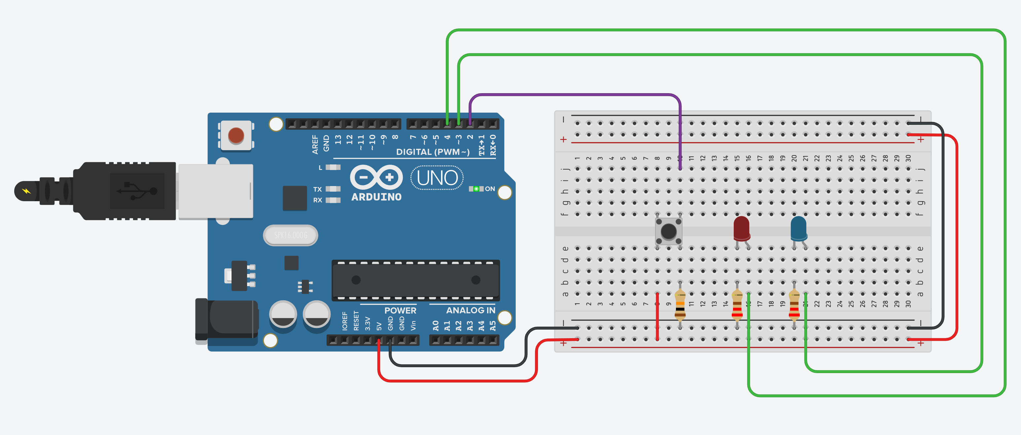
Step 4: Connecting our LEDS
Let’s connect our two LEDs.
A 220Ω resistor connects the cathode (left pin) to the ground bar of the breadboard, and a wire connects the anode (right pin) to a digital pin on the Arduino.

Slide 23
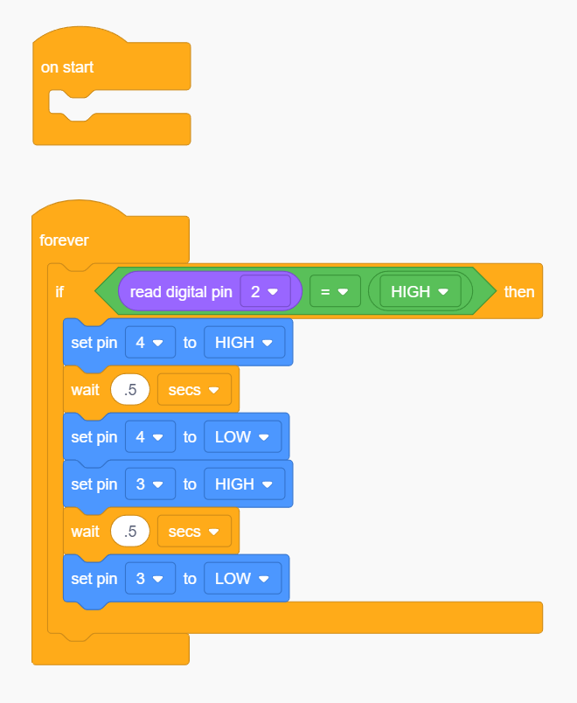
Step 5: Code the logic
When the pushbutton is pressed, the pin it is connected to (Pin 2) will be set to a HIGH state.
If Pin 2 is HIGH, we will execute the code from Project 1 to blink the two LEDs.
As long as the pushbutton continues to be pressed, the LEDs will continue to blink.

Slide 24
Project 3: Ultrasonic Distance Sensor

Slide 25
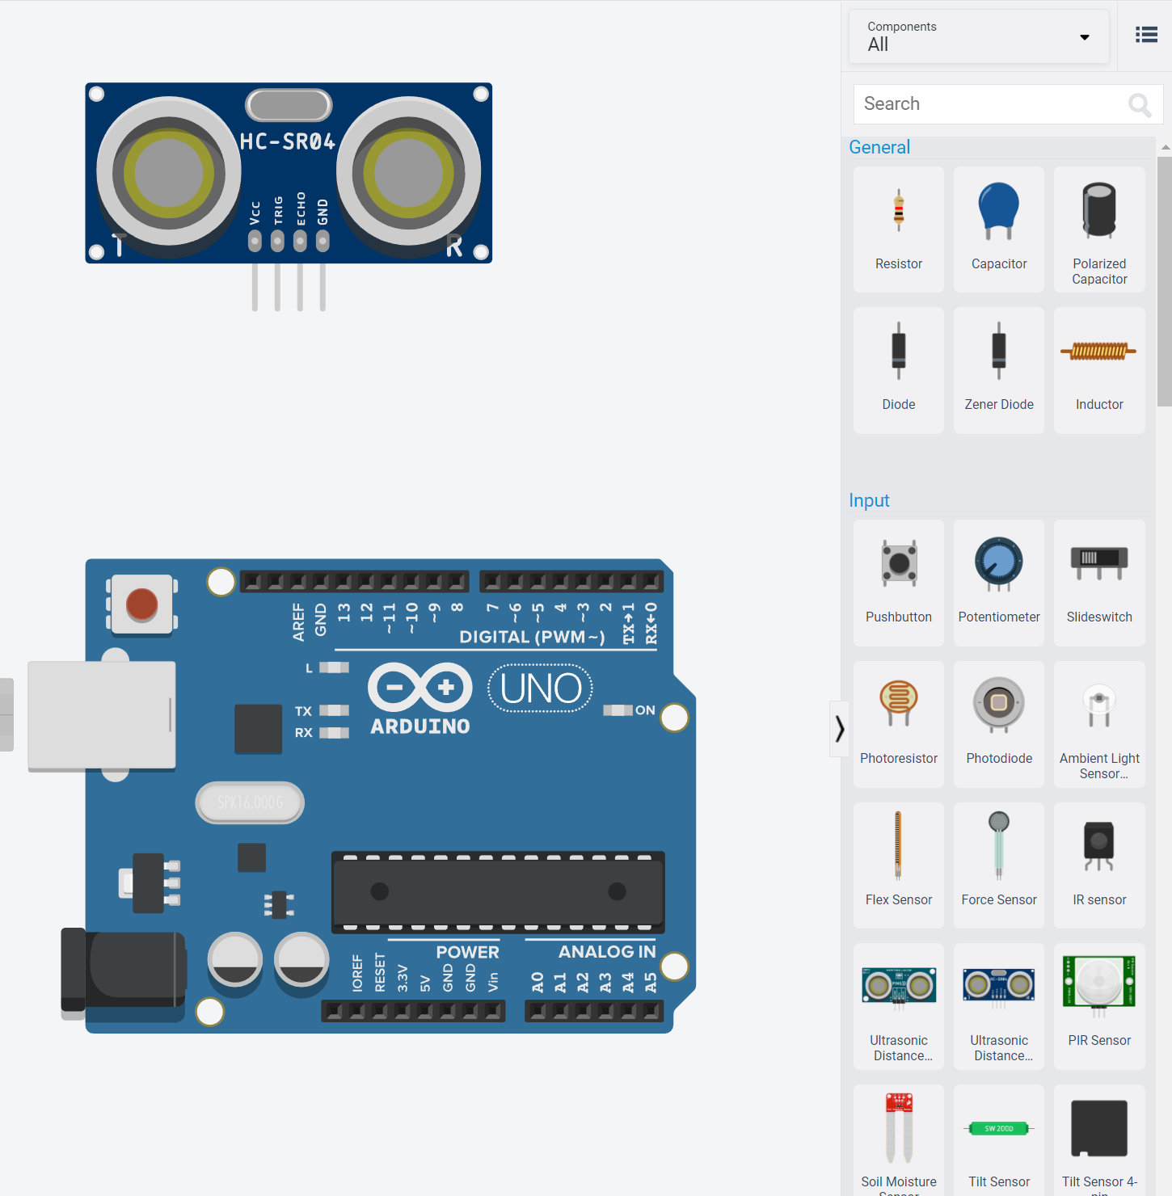
Step 1: Add The Sensor
We’ll be using the 4-pin Ultrasonic Distance sensor. To find it, change the menu at the top of the components list from “Basic” to “All”

Slide 26
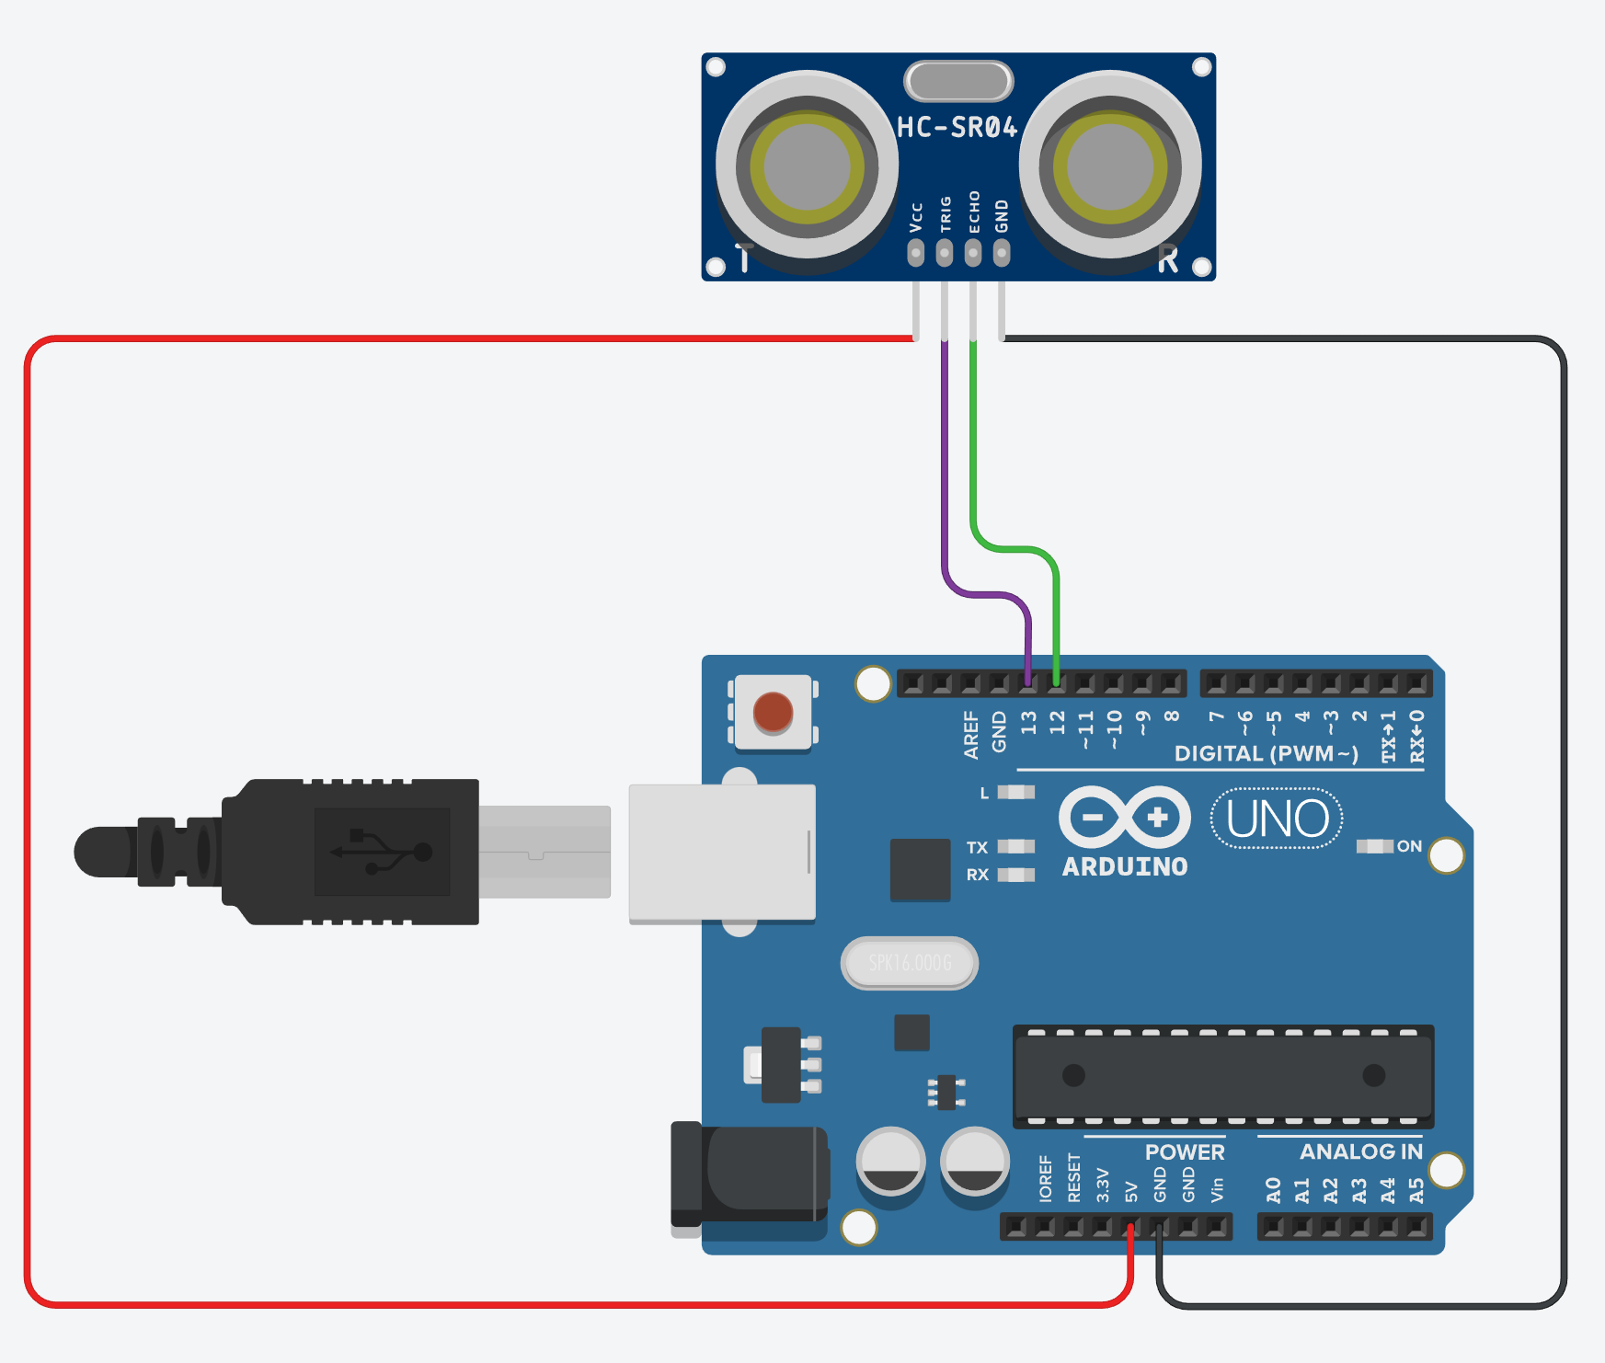
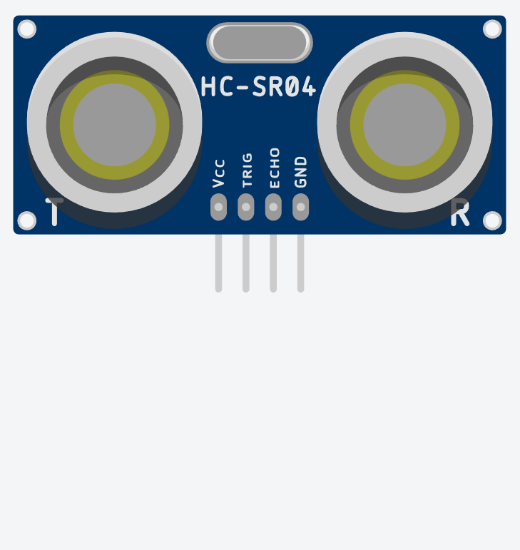
Step 2: Wiring The Sensor
Power (Vcc)
Ground (GND)
Trigger
(Input)
Echo
(Output)

Slide 27
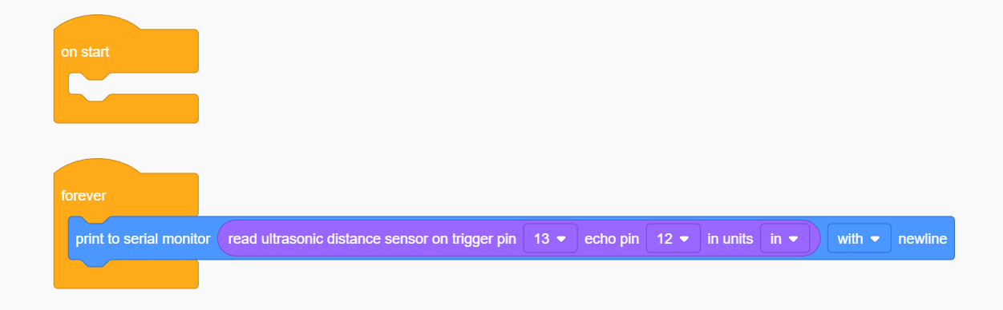
Step 3: Code The Sensor
Let’s start by printing out the distance from the sensor to any object. For this, we’ll use the “Print to Serial Monitor” block.
From the purple Input category of blocks, we’ll select “read ultrasonic distance sensor…” as our value to display. Set the trigger pin and echo pin numbers according to your wiring.

Slide 28
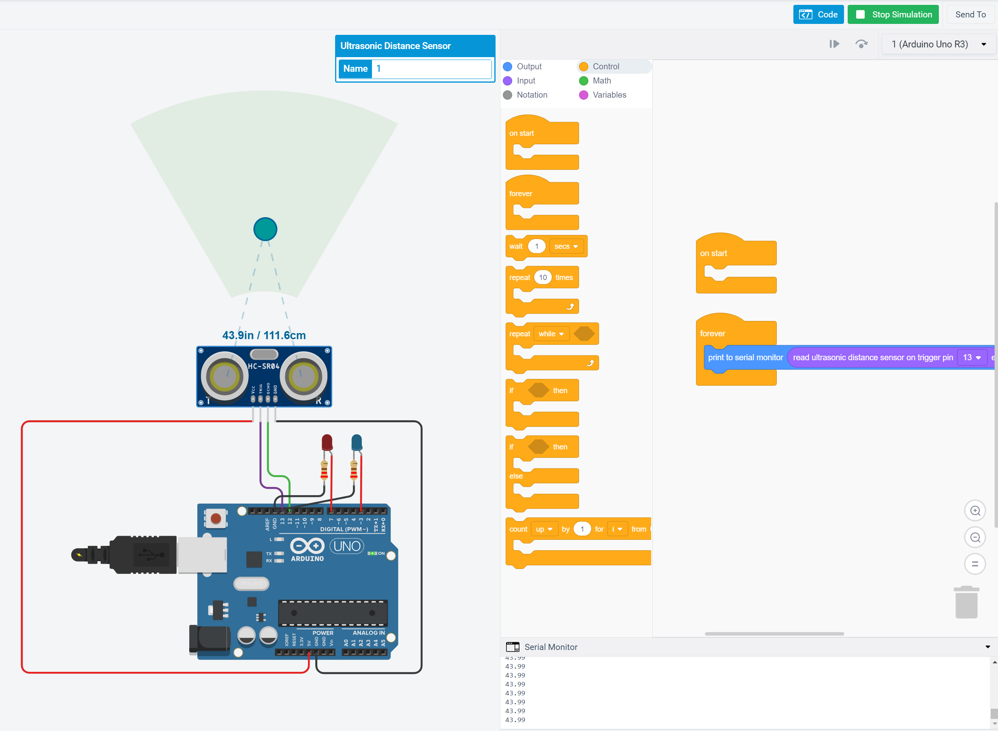
Step 4: Test the Sensor
Select “Start Simulation”
At the bottom of the coding panel, click “Serial Monitor” to open our display window, where the distance read by our sensor will be written.
With the sensor selected, drag the blue dot around inside the detection cone, and watch the values in the serial monitor change in response.

Slide 29
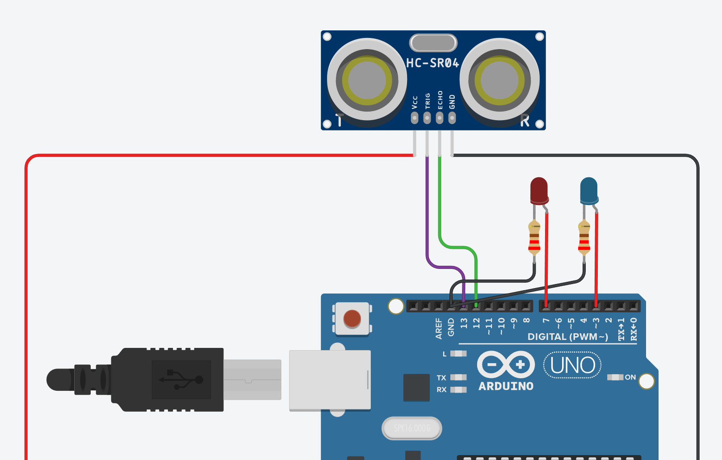
Step 5: Adding some LEDS
Let’s connect our two LEDs again.
As usual, 220Ω resistors connect them to ground, and the anodes connect to digital pins (I’ve used 7 and 3).

Slide 30
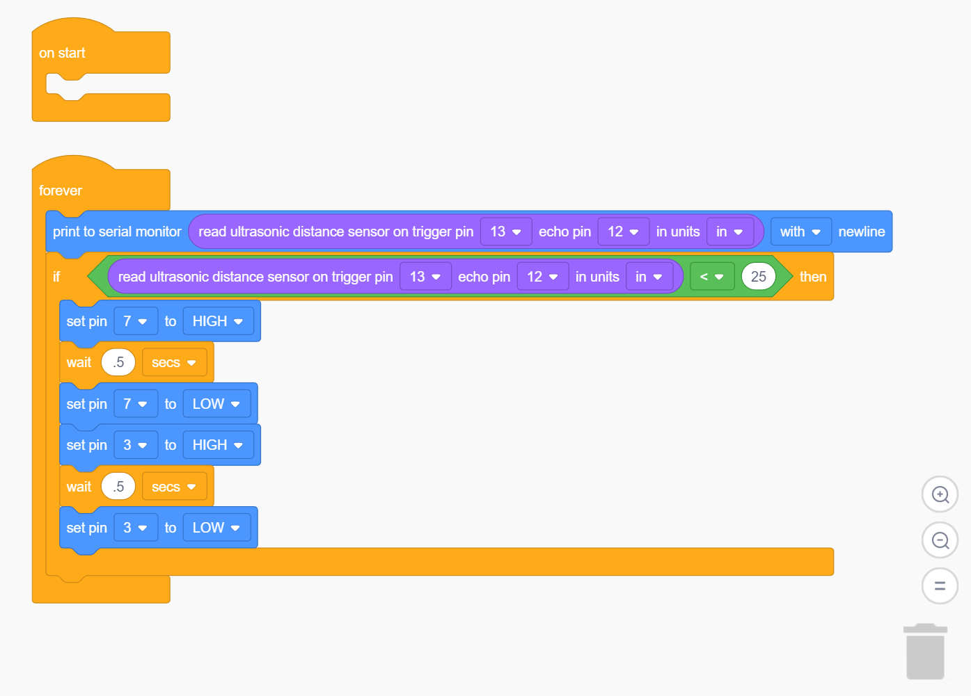
Step 6: Wiring the Lights
Below the “print to serial monitor” block, let’s add an if block similar to the one we used for the pushbutton.
Instead of reading the pushbutton, though, we’ll read out ultrasonic distance sensor. If the value read falls below (less than, <) a specific value, then our lights will flash in alarm.
I’ve selected a range of 25 inches.

Slide 31
Project 3: Countdown timer

Slide 32
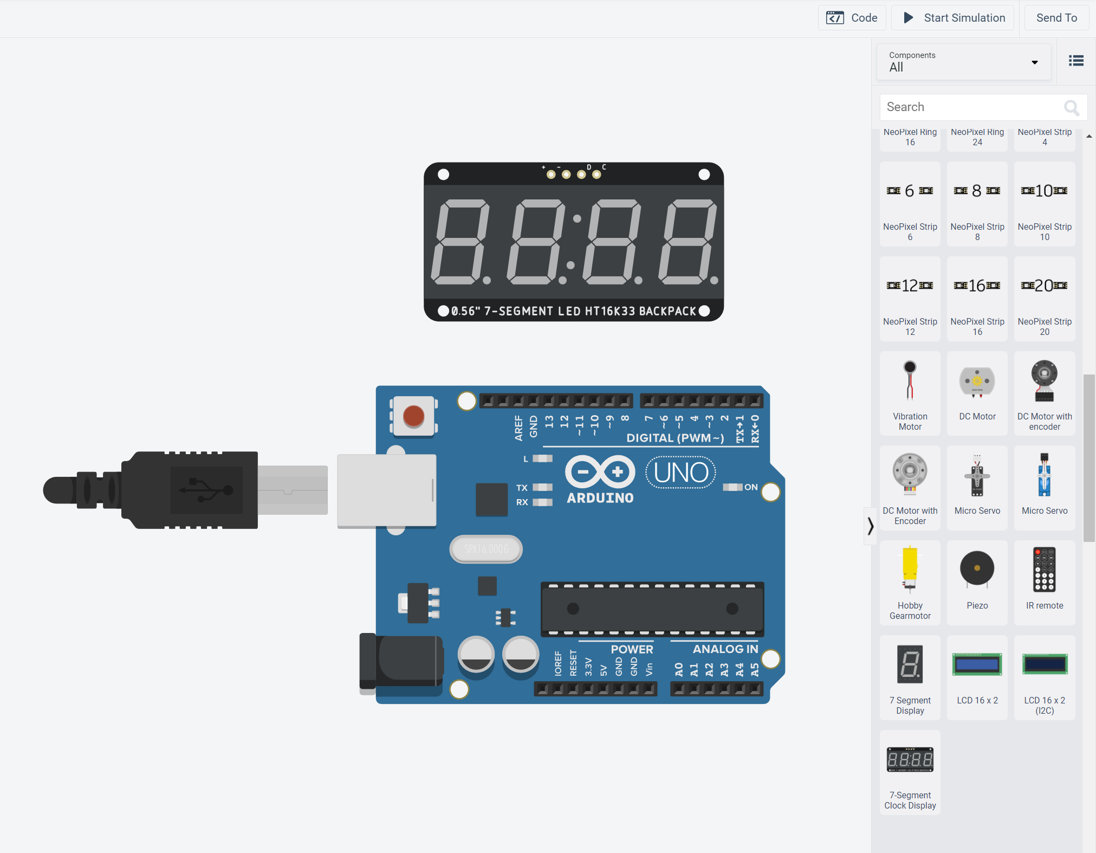
Step 1: Adding a 7-Segment clock Display
The “7-Segment Clock Display” can be found under All components.
There are several other displays, but this one is simplified to only 4 pins.

Slide 33
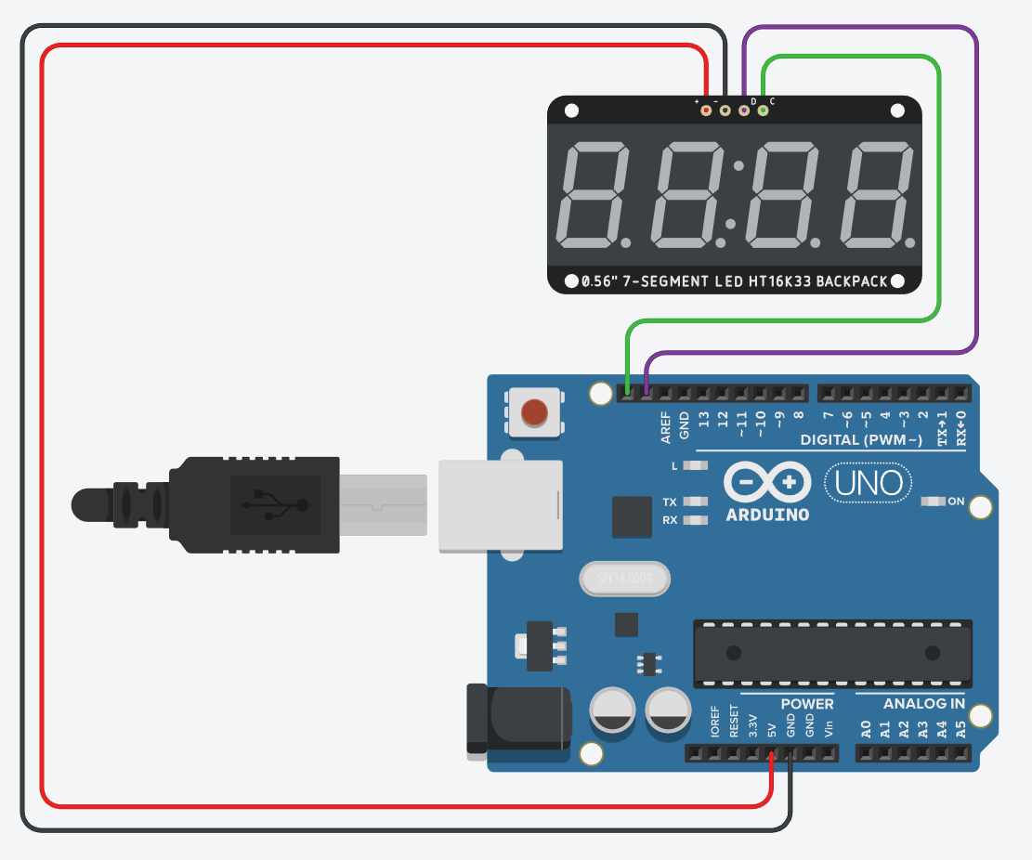
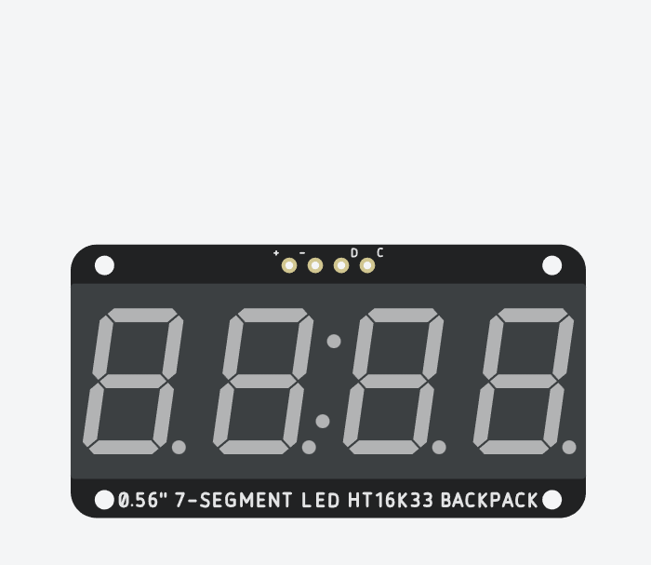
Step 2: Wiring The Display
SCL and SDA refer to two specific pins on the Arduino.
They aren’t labeled, but hovering the cursor over them will reveal their names.
Ground (GND)
Serial Data (SDA)
Serial Clock (SCL)
Power (Vcc)

Slide 34
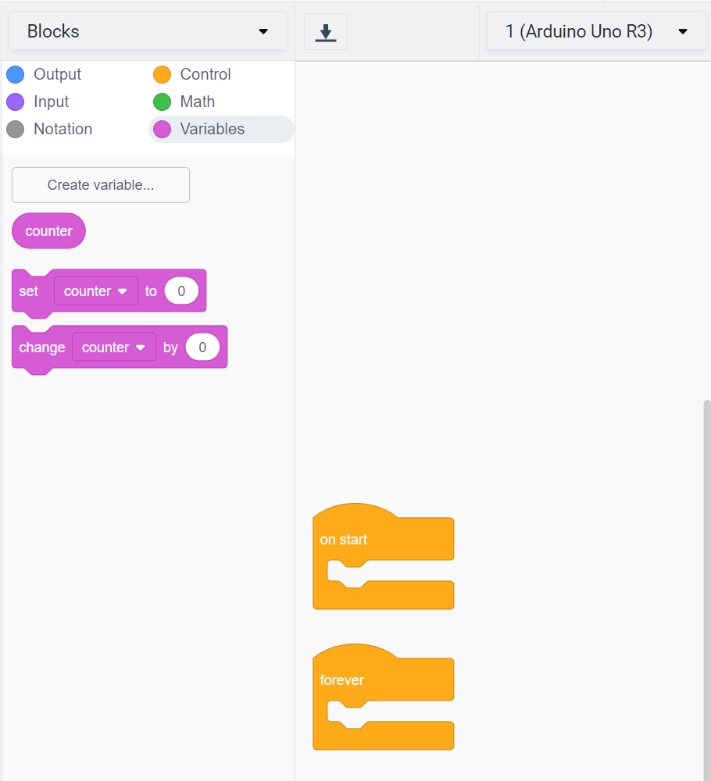
Step 3: Coding the Display
For this project, we are going to use a new block type – a variable.
A variable allows us to store values, and modify their contents as our program is running.
Select the “Variables” category, and click on “Create variable…”
Name your new variable counter, and click “Okay”

Slide 35
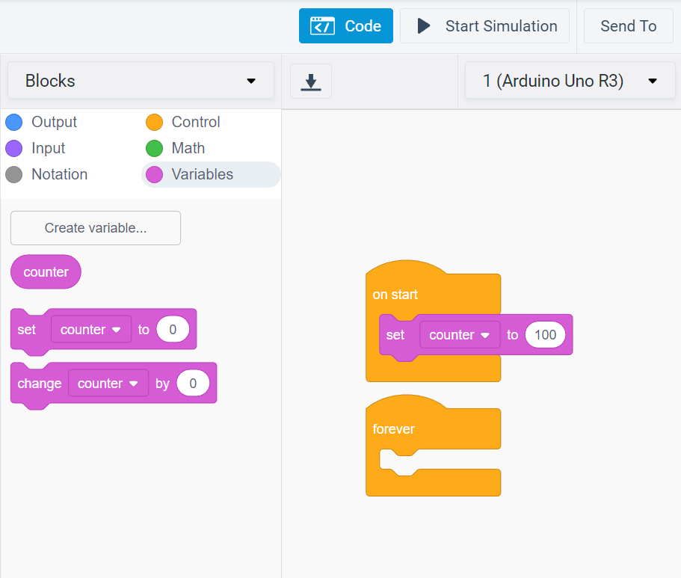
Step 4: Coding continued
Next, we’re going to use the “On Start” section to set a starting point for our counter variable.
Drag the “set counter to 0” block into the “on start” section. Choose a starting value for your countdown timer (I’ve used 100 here).

Slide 36
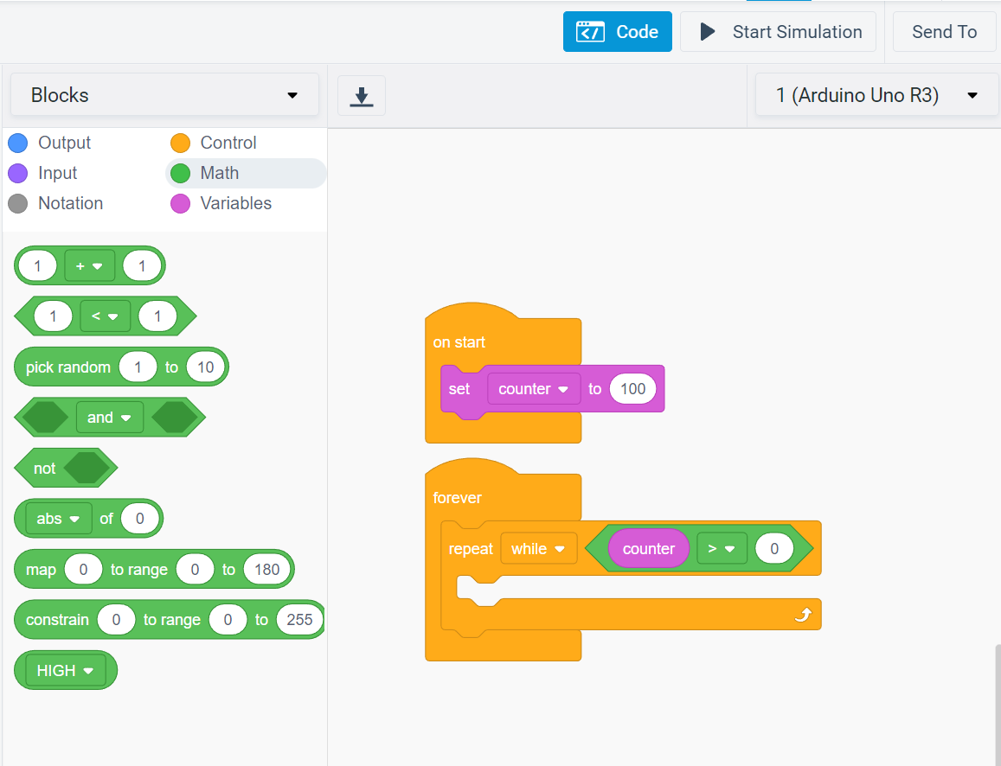
Step 5: Starting the countdown
In the “Forever” section, let’s add a “Repeat while…” block from Control.
For the missing element, drag the comparison block (1 < 1) from the Math category.
Fill in the left-hand circle with counter from the Variables category.
Change the symbol from less than to greater than.
Change the right-hand circle to 0.

Slide 37
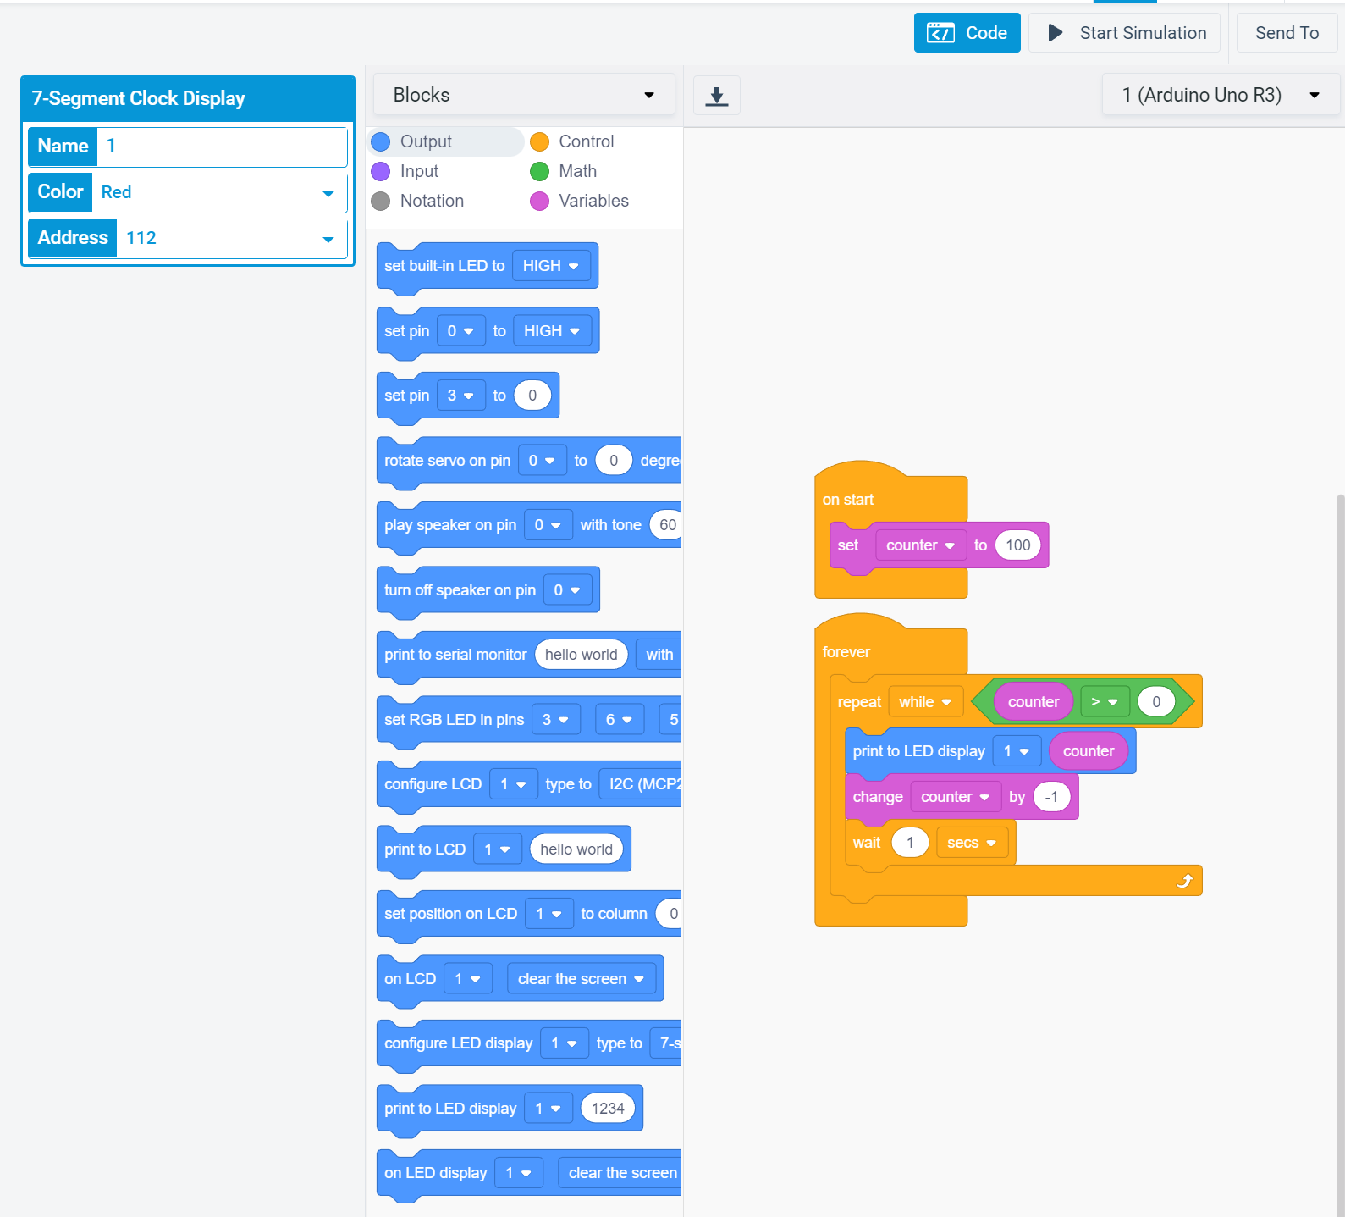
Step 6: Counting Down!
The name of the Display here should match the number in the dropdown of the “print to LED display” block.
Drag a “Print to LED display…” block from Output into our “Repeat” block.
Fill the circle with the counter variable.
Next, let’s subtract one from counter.
Drag a “Change counter by…” block from the Variables category.
Change the value to -1 to subtract.
Finally, let’s add a “Wait” block to make our timer pause 1 second between each value.

Slide 38
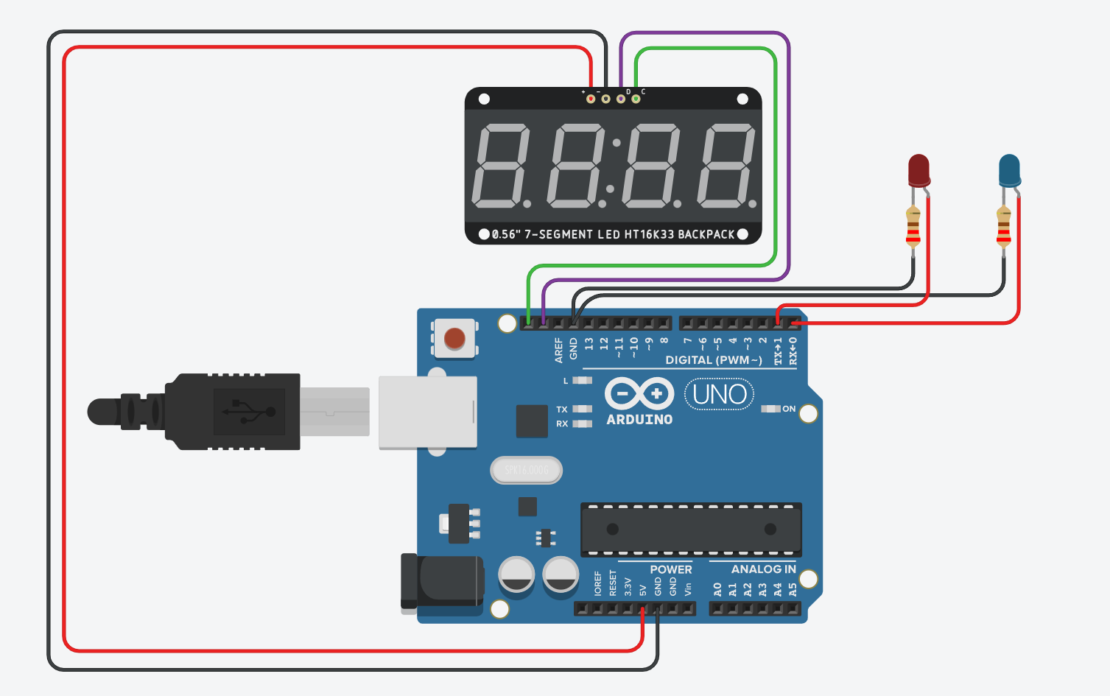
Step 7: Adding Some LEDS
Let’s add some LEDs to start flashing AFTER our countdown ends.
As usual, 220Ω resistors connect them to ground, and the anodes connect to digital pins (I’ve used 1 and 0).

Slide 39
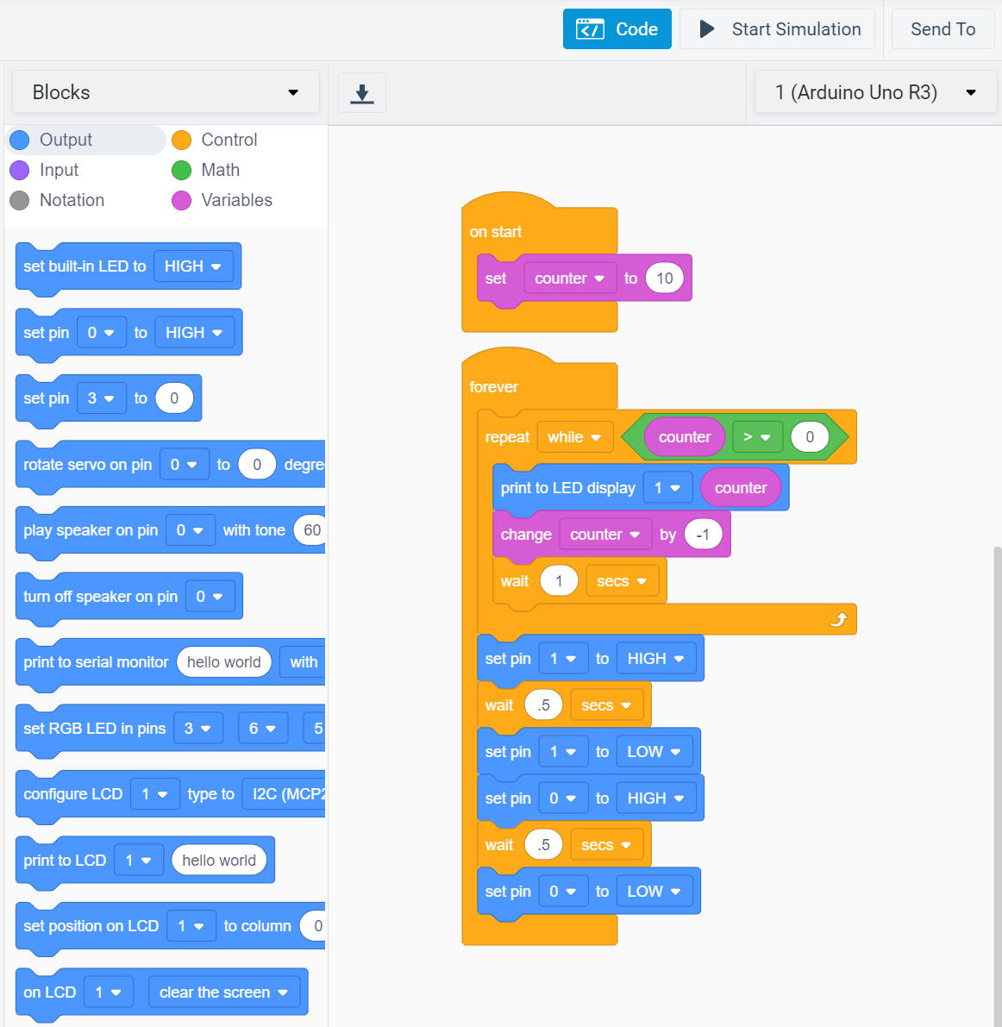
Step 8: Countdown Over!
Only the statements inside the Repeat block will run (over and over again), until the counter reaches zero.
Once the Repeat block finally ends, anything after it will begin. Let’s put the blocks for our flashing lights there.
They won’t start until after the countdown ends, but then they’ll keep going forever.

